Slide 1


CITS1003 Introduction to Cybersecurity [9-A] Cyber Law and CI & CPS exercises
Dr Zhi Zhang

Slide 2
Privacy preserving
Secure Multi-Party Computation (SMPC)
Differential Privacy (DP)
Homomorphic Encryption (HE)
Software-induced hardware vulnerability: Rowhammer

Slide 3
What is privacy
Privacy refers to the ability of individuals to control the access and use of their personal information (e.g., gender, age, phone number, etc).

Slide 4
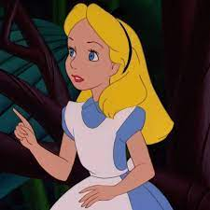

What is Privacy
provides personal information
to sign up for a membership
Alice
Why does Costco collect users’ private data?

Slide 5
What is Privacy
Model Training
provide dataset
Well-trained
Model
e.g., her favourite items

Slide 6
What is Privacy Preserving
provide anonymized
users’ data
Model Training

Slide 7
What is Privacy Preserving
Privacy preserving
protects data from being disclosed to unauthorized parties
enables the collection and statistical analysis of data

Slide 8
What is Privacy Preserving
Privacy preserving
protect data from being disclosed to unauthorized parties
enable the collection, and analysis of data
How to collect and analyze data without leaking private information?

Slide 9
Privacy Preserving
Privacy preserving
protect data from being disclosed to unauthorized parties
enable the collection, and analysis of data
How to collect and analyze data without leaking private information?
Data anonymization: hide personal identifiers that may lead to an individual being identified
e.g., data masking: remove personally identifiable data such as user names and credit card details.

Slide 10
Privacy Preserving
Data anonymisation: removing personal identifiers that may lead to an individual being identified
Data anonymisation is NOT secure enough
e.g., data linking attack: correlates anonymized data with publicly available data to re-identify individuals.

Slide 11

What is Privacy Preserving
A Hospital
A Third-party
Data Analytics Company
Raw Medical Records
(e.g., patients’ names, genders, ages, diseases, addresses and postcodes)
Data Anonymization
Anonymized Medical Records
(e.g., names, addresses and postcodes are masked,
while genders, ages and diseases are kept)
A Third-party
Data Analytics Company

Slide 12
What is Privacy Preserving
A Hospital
A Third-party
Data Analytics Company
Raw Medical Records
(e.g., patients’ names, gender, age, addresses and postcode)
Public Data
(e.g., voting records and social media profiles)
Data Anonymization
Patient Re-identification
Anonymized Medical Records
(e.g., names and addresses are masked,
while gender, age and postcode are kept)
A Third-party
Data Analytics Company

Slide 13
Privacy Preserving
Data anonymisation: removing personal identifiers that may lead to an individual being identified
Data anonymisation is NOT secure enough
Secure multi-party computation
Differential privacy
Homomorphic encryption

Slide 14
Secure Multi-party Computation
Secure multi-party computation is a privacy concept that distributes a computation across multiple users where no user can see the other users’ private data.

Slide 15
Secure Multi-party Computation
Secure multi-party computation is a privacy concept that distributes a computation across multiple users where no user can see the other users' private data.
e.g., additive secret sharing: refers to the division of a secret and its distribution among a group of independent participants.

Slide 16

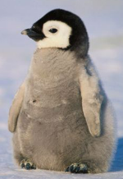
Secure Multi-party Computation
Situation: Three coworkers--Alice, Emu and Penguin—want to compute their average hourly rate
Requirement: They do not want to reveal their own rate to each other.
Alice (A)
$50
Emu (E)
$120
Penguin (P)
$180
https://stock.adobe.com/search?k=emu+cartoon

Slide 17
Secure Multi-party Computation
Steps:
1. Each staff splits their rate randomly into n (n=3) secret shares
A: $50
E: $120
P: $180

Slide 18
Secure Multi-party Computation
Steps:
1. Each staff splits their rate randomly into 3 secret shares
A: $50 -> $10, $5, $35
E: $120 -> $25, $100, -$5
P: $180 -> $10, $100, $70
2. Each staff keeps one secret share and distributes the remaining two secret shares to the other two staffs.

Slide 19
Secure Multi-party Computation
After secret sharing is completed:
A | E | P
5 | 35 | 10
100 | 25 | -5
70 | 10 | 100
A = 50
E = 120
P = 180

Slide 20
Secure Multi-party Computation
After secret sharing is completed:
A
5
100
70
A = 50
E = 120
P = 180

Slide 21
Secure Multi-party Computation
After secret sharing is completed:
 | E
 | 35
 | 25
 | 10
A = 50
E = 120
P = 180

Slide 22
Secure Multi-party Computation
After secret sharing is completed:
 |  | P
 |  | 10
 |  | -5
 |  | 100
A = 50
E = 120
P = 180

Slide 23
Secure Multi-party Computation
After secret sharing is completed:
A | E | P
5 | 35 | 10
100 | 25 | -5
70 | 10 | 100
A = 50
E = 120
P = 180

Slide 24
Secure Multi-party Computation
After secret sharing is completed:
A | E | P
5 | 35 | 10
100 | 25 | -5
70 | 10 | 100
175 | 70 | 105
A = 50
Sum: 350
E = 120
P = 180
Sum: 350
Average: 350/3 = 116.67

Slide 25
Secure Multi-party Computation
What are limitations of SMPC in practice?

Slide 26
Secure Multi-party Computation
What are limitations of SMPC in practice?
e.g., computational overhead and communication cost

Slide 27
Secure Multi-party Computation
What if one coworker is dishonest and distributes false secret shares?
e.g., Zero Knowledge Proof
Zero Knowledge Proof is a cryptographic protocol by which one party (a prover) can prove to another party (a verifier) that a statement is true, without revealing any information apart from the fact that this specific statement is true.

Slide 28
Zero Knowledge Proof
Situation: Alice and Bob want to find a friend called Wally in a given image. Alice has knowledge of where Wally is in the image, but Bob doesn’t believe Alice.
How does Alice prove to Bob that she knows where Wally is without giving away Wally’s location in the image?

Slide 29
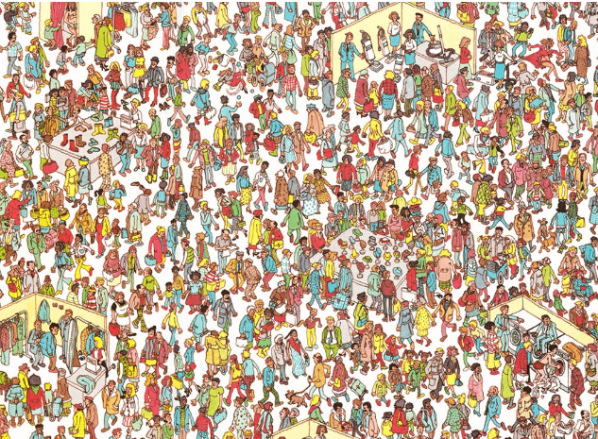

Slide 31
Differential Privacy
Differential privacy (DP) is also a concept in privacy that aims to provide strong guarantees for protecting the privacy of individuals in a dataset while allowing statistical analysis of the dataset.

Slide 32
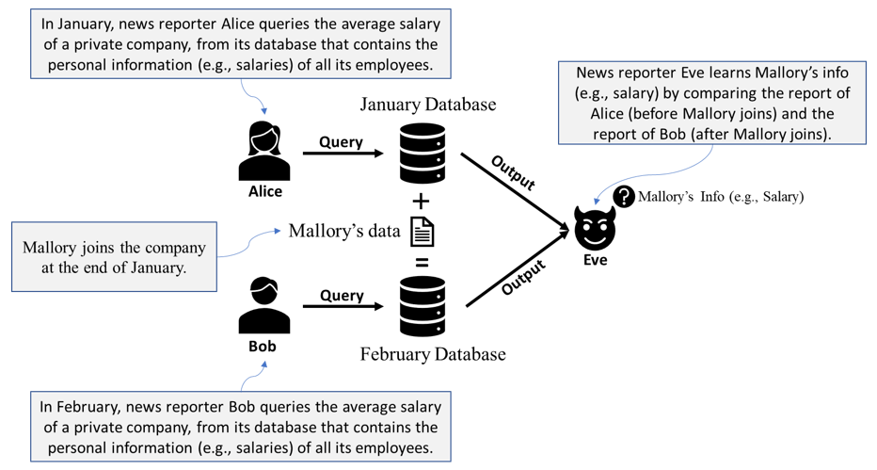
User Privacy Inference

Slide 33
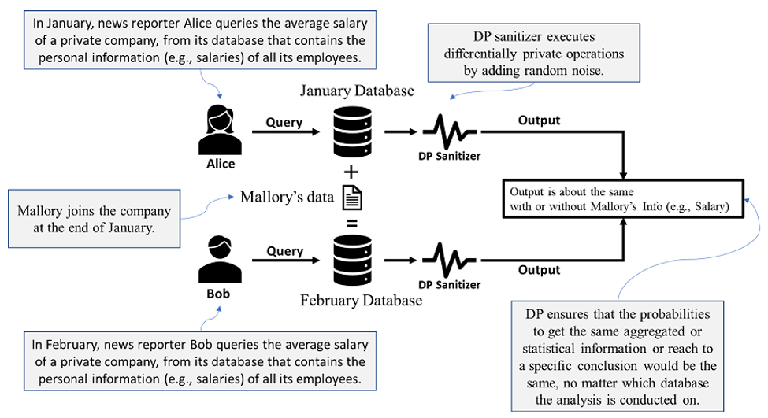
Differential Privacy

Slide 34
Differential Privacy
Differential privacy (DP) is also a concept in privacy that aims to provide strong guarantees for protecting the privacy of individuals in a dataset while allowing statistical analysis of the dataset.
The key difference between DP and SMPC
DP focuses on a statistical analysis of a dataset
SMPC focuses on multiple parties that perform a collaborative computation

Slide 35
Homomorphic Encryption
Homomorphic Encryption (HE) is a type of encryption that allows computations to be performed on encrypted data, making itself computationally expensive.

Slide 36
Homomorphic Encryption
Homomorphic Encryption (HE) is a type of encryption that allows computations to be performed on encrypted data, making itself computationally expensive.
HE
encryption
computing
operation
HE
decryption
Encrypted
Texts
Encrypted
Computation Results
Decrypted Computation Results
Plaintext
homomorphically same computing operation
Computation Results

Slide 37

Homomorphic Encryption
Cloud Server
Computed Result:
F(E(A), E(B))
Ciphertext E(A)
Ciphertext E(B)
Computing Request:
F()
HE Encryption
HE Decryption
Plaintext A
Plaintext B
Decrypted Computed Result:
D(F(E(A), E(B)))
F(A, B)
Alice

Slide 38
Homomorphic Encryption
Fully HE (FHE) enables any computations to be performed on encrypted data, such as addition, subtraction, multiplication and division.
Partially HE (PHE) enables certain types of computations (not all) to be performed on encrypted data. Specifically, PHE allows for either addition or multiplication operations.

Slide 39
Homomorphic Encryption
Fully HE (FHE) enables any computations to be performed on encrypted data, such as addition, subtraction, multiplication and division.
e.g., BGV (Brakerski-Gentry-Vaikuntanathan)
Partially HE (PHE) enables certain types of computations (not all) to be performed on encrypted data. Specifically, PHE allows for either addition or multiplication operations.
e.g., RSA (homomorphic multiplication)
Paillier (homomorphic addition)

Slide 40
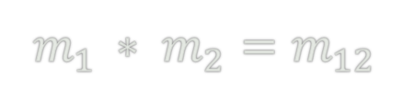

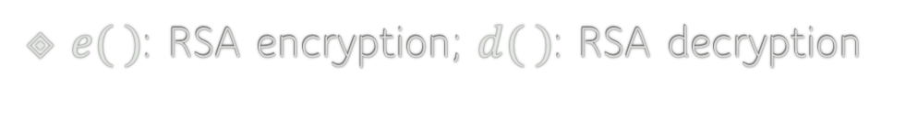
RSA: Homomorphic Multiplication
$e( )$: RSA encryption; $d( )$: RSA decryption
$$m_{1 }∗ m_{2}=m_{12}$$
$${e(m}_{1 })∗{e(m}_{2 })={e(m}_{1 }∗ m_{2})=e(m_{12})$$
Homomorphic Multiplication
$${d(e\left(m_{12}\right))=d(e(m}_{1 }) ∗{e(m}_{2 }))=m_{1 }∗ m_{2}$$

Slide 41
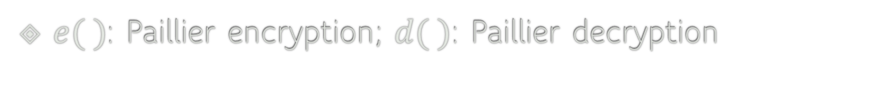
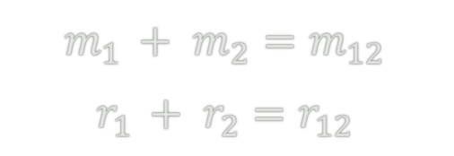
Paillier: Homomorphic Addition
$e( )$: Paillier encryption; $d( )$: Paillier decryption
$$m_{1 }+ m_{2}=m_{12}$$
$$r_{1 }+ r_{2}=r_{12}$$
$${e(m}_{1 }, r_{1 })∗{e(m}_{2 }, r_{2 })={e(m}_{1 }+ m_{2}, r_{1 }+ r_{2})=e(m_{12}, r_{12})$$
Homomorphic Addition
$${d(e\left(m_{12}, r_{12}\right))=d(e(m}_{1 },r_{1 }) ∗e(m_{2}, r_{2}))=m_{1 }+ m_{2}, r_{1 }+ r_{2}$$

Slide 42
Homomorphic Encryption
What are the pros and cons of HE?

Slide 43
Homomorphic Encryption
What are the pros and cons of HE?
Pros:
HE allows computation on encrypted data, ensuring data privacy.
HE is versatile as it can be used for many privacy-preserving tasks.
Cons:
HE is computationally expensive, and the computational overhead increases with the complexity of the computation.

Slide 44
Rowhammer
Rowhammer is a severe vulnerability in hardware, which can be induced by an unprivileged attacker.
Rowhammer can be exploited to break the CIA of data including privacy-preserving algorithms.

Slide 45
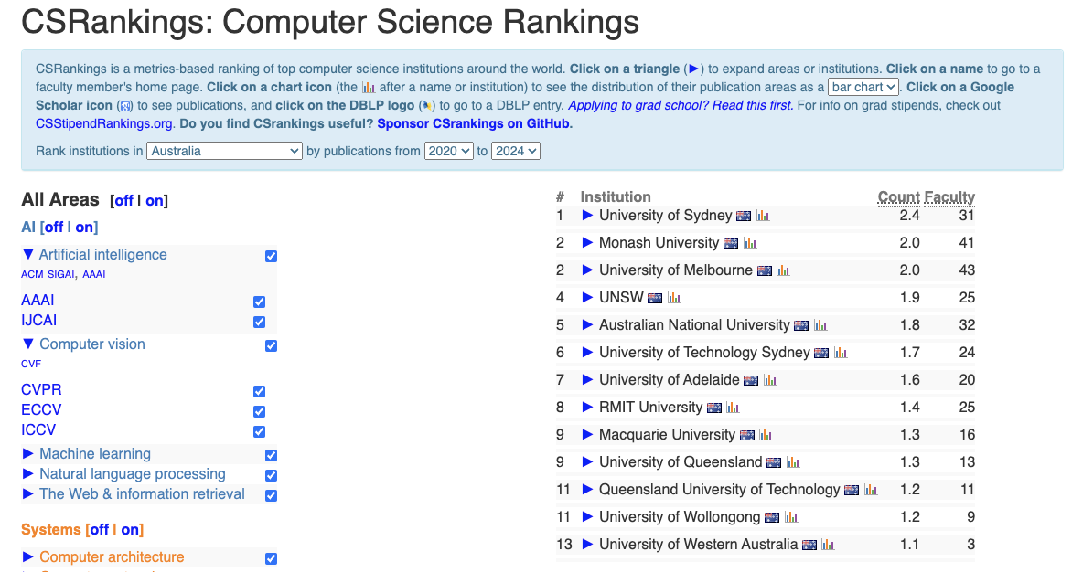
CSRankings
csrankings.org:

Slide 46
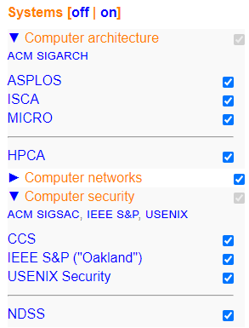
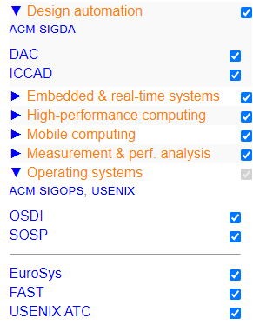

Slide 47
DAC’20 DAC’24‬
MICRO’20‬
HPCA’24‬
CCS’24‬
IEEE S&P’24‬
USENIX Security’24‬
NDSS’23‬
USENIX ATC’22‬
‪My Google Scholar: ‪Zhi Zhang‬ - ‪Google Scholar‬

Slide 48
Rowhammer against Crypto
CVEs:
CVE-2023-51939 BBS
CVE-2024-1545 RSA
CVE-2024-2881 EdDSA
CVE-2024-28285 Elgamal
CVE-2024-31510 ML-DSA
Acknowledgments from the industry:
https://www.wolfssl.com/docs/security-vulnerabilities/

Slide 49
Rowhammer
Rowhammer is a severe security vulnerability in dynamic random-access memory (DRAM).
DRAM Memory
Disk Storage

Slide 50
Rowhammer
Rowhammer is a severe security vulnerability in dynamic random-access memory (DRAM).
DRAM Memory
DRAM is volatile memory that stores data temporarily while the computer is running.
Disk Storage
Disk space refers to the amount of non-volatile storage space available on a disk drive.

Slide 51
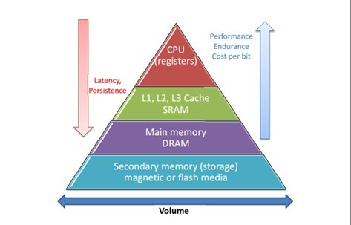
Rowhammer
Rowhammer is a severe security vulnerability in dynamic random-access memory (DRAM).
DRAM Memory
Disk Storage

Slide 52
Rowhammer
Rowhammer is a severe security vulnerability in dynamic random-access memory (DRAM).
Rowhammer can badly affect any devices that use DRAM, including but not limited to:
IoT devices such as routers and smart home devices.
Personal computers such as Desktops and laptops.
Mobile devices such as smartphones and tablets.
Servers

Slide 53
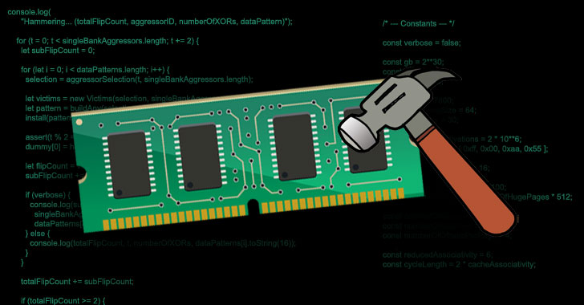
Rowhammer
DRAM rows
Frequently accessing
Rowhammer
https://thehackernews.com/2021/04/new-javascript-exploit-can-now-carry.html

Slide 54
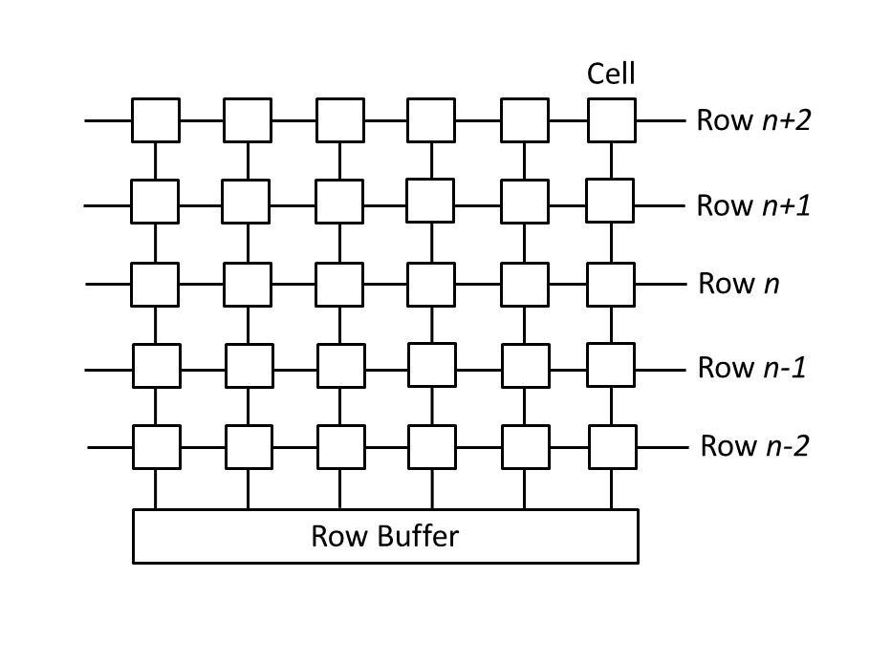
A memory access opens a DRAM bank
A bank has rows of cells
A cell is either charged or discharged to store bit 0 or 1

Slide 55
A memory access opens a DRAM bank
A bank has rows of cells
A cell is either charged or discharged to store bit 0 or 1
Row buffer facilitates memory access
Alternating row access clears row buffer

Slide 56
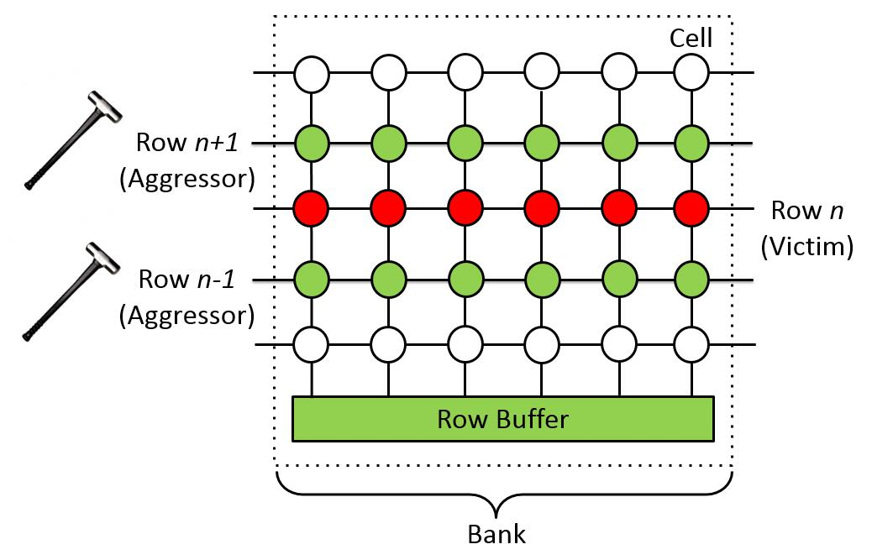
Rowhammer
Kim et al. key observation (ISCA’14)
Frequently opening rows n+1 & n-1 cause permanent charge leakage in row n. Permanent charge leakage means bit flips

Slide 57
Rowhammer code
Code from Kim et al.
1 loop:
2 mov (X), %eax
3 mov (Y), %ebx
4 clflush (X)
5 clflush (Y)
6 jmp loop
What is purpose of lines 2-3?
Clear row buffer (e.g., alternate access)

Slide 58
Rowhammer code
Code from Kim et al.
What is the purpose of lines 4-5?
1 loop:
2 mov (X), %eax
3 mov (Y), %ebx
4 clflush (X)
5 clflush (Y)
6 mfence
7 jmp loop
flush CPU cache (e.g., clflush)

Slide 59
Rowhammer
PoC: Proof of Concept
OS
User Space
Attacker Process
Kernel Space
Page Table
Hardware (e.g., CPU cache, DRAM memory and Disk)

Slide 60

Rowhammer
PoC: Proof of Concept
attacker process
…
…
…
…
…
…
page table
…
…
…
…
…
…
attacker process

Slide 61
Rowhammer
PoC: Proof of Concept
$: a regular user process and its user id is greater than 0.
#: a root user process and its user id is set to 0.

Slide 62
Rowhammer
PoC: Proof of Concept

Slide 63
Rowhammer
Kim et al. key observation (ISCA’14)
Motivated by Kim et al., we compromised a bug-free kernel by gaining privilege escalation in Blackhat’19
Blackhat’19: https://www.youtube.com/watch?v=7vQXhC6dq2Q&t=1930s

